Slide 1
Intro to Node Servers
Lesson 11.1

Slide 2
A new face in the classroom
My name’s Catherine Pham, and I am a former wildlife biologist. I graduated from the UW boot camp in June 2019, and since then, I’ve TA-ed, tutored, and gotten a full-time job with iSoftStone, a global tech consulting company over in Kirkland.
Feel free to connect with me on Slack and LinkedIn!
https://www.linkedin.com/in/catherinephamcww/
In modern web applications there is a constant back-and-forth communication between the visuals displayed on the user’s browser (frontend) and the data and logic stored on the server (backend).
Intro to Node Servers

Slide 3
A Moment of Caution
Intro to Node Servers

Slide 4

Node and Express servers and routing are two of the most important concepts in the entire program.
Intro to Node Servers

Slide 5

Forewarning: This Is the Challenging Stuff
The topics we’ll cover over the next three weeks will be challenging at times, but it’s also some of the most important material. This is when you’ll go from humble HTML/CSS hackers to employable full-stack engineers. Bring your A game!
Intro to Node Servers
Notes:
This image is public domain: https://en.wikipedia.org/wiki/Rosie_the_Riveter

Slide 6
Tips for Success
Form a study group. Get in the habit of explaining in-class exercises to one another, and work together on homework assignments.
Take notes! Jot down key concepts and ideas that come out of the in-class activities to help you keep things straight!
Ask “conceptual” questions. It’s important to understand the big picture, so if a key concept is confusing, be sure to ask about it!
Come to office hours. Seeking help during office hours will be increasingly valuable as the material becomes more complex. Come to these sessions and ask questions! We’re here to help you.
Intro to Node Servers

Slide 7
Want a Helpful Resource?
Sign up for a Pluralsight trial account and take their Building Blocks of Express.js course.
pluralsight.com
Intro to Node Servers

Slide 8

Be Confident!
Remember: If you’ve made it this far, you’ve proven that you have what it takes to succeed. Keep going!
Intro to Node Servers
Notes:
Image source: shutterstock_1037716798

Slide 9
Remember Our Mantra:
When it comes to web development…
Intro to Node Servers

Slide 10
I know nothing.
Intro to Node Servers

Slide 11
You
Notes:
Seriously. Don’t lose sight of this image. At first it may feel intimidating, knowing how little you know. But relish the opportunity and take the privileges it comes with.
You have permission to struggle. To fail. To not “get” everything immediately.

Slide 12
So Let’s Begin
Intro to Node Servers

Slide 13

Remind Me Again
What is a server?
In modern web applications there is a constant back-and-forth communication between the visuals displayed on the user’s browser (frontend) and the data and logic stored on the server (backend).
Intro to Node Servers
Notes:
Image source: shutterstock_1051979417

Slide 14
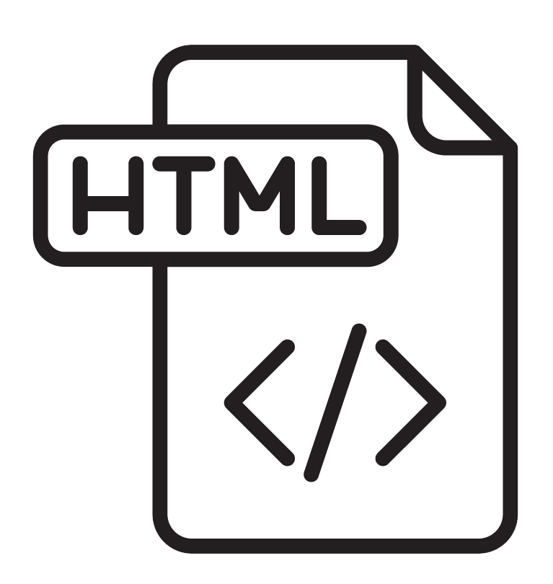

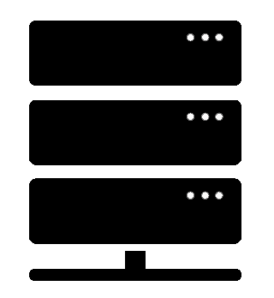
What Is a Server?
A server is the machine and code that handles client requests and responds to them.
The client's request contains the name and address
(the URL) of whatever the client is looking for.
Client Request
The server usually has a lot of content that it can send to clients. This content can be webpages, JPEGs, and other resources.
Server
Web Browser (Client)
Response
The server's response contains the actual
document that the client requested (or an
error code if the request cannot be processed).
Intro to Node Servers
Notes:
Server is just another computer that happens to serve other computers (clients)

Slide 15
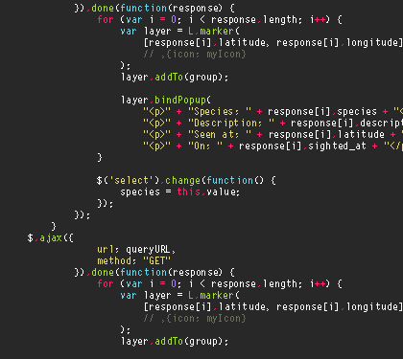

Remind Me Again
What are some examples of server-side functions?
In modern web applications there is a constant back-and-forth communication between the visuals displayed on the user’s browser (frontend) and the data and logic stored on the server (backend).
Intro to Node Servers
Notes:
Image source: shutterstock_1051979417

Slide 16
Server-Side Code in Action!
Visiting a URL and then being presented with an HTML page
Visiting an API endpoint that parses URL parameters to provide selective JSONs
Clicking an invoice that provides a PDF report
Image-processing software that applies a filter to an image and saves the new version
Google providing results relevant to searches on other sites
Intro to Node Servers

Slide 17

Remind Me Again
What is a client?
Client
In modern web applications there is a constant back-and-forth communication between the visuals displayed on the user’s browser (frontend) and the data and logic stored on the server (backend).
Server
Intro to Node Servers
Notes:
Image source: shutterstock_1051979417

Slide 18
What Is a Client?
A client is a user’s personal machine which makes “requests” of the server.
The client's request contains the name and address
(the URL) of whatever the client is looking for.
The server usually has a lot of content that it can send to clients. This content can be webpages, JPEGs, and other resources.
Client Request
Server
Web Browser (Client)
Response
The server's response contains the
document that the client requested (or an
error code if the request cannot be processed).
Intro to Node Servers

Slide 19

Remind Me Again
How do the client and server communicate with each other?
In modern web applications there is a constant back-and-forth communication between the visuals displayed on the user’s browser (frontend) and the data and logic stored on the server (backend).
Intro to Node Servers

Slide 20
HTTP/HTTPS
Clients and servers communicate with each other using a series of requests and responses defined by HTTP / HTTPS (Hypertext Transfer Protocol Secure).
The client's request contains the name and address
(the URL) of whatever the client is looking for.
The server usually has a lot of content that it can send to clients. This content can be webpages, JPEGs, and other resources.
Client Request
Server
Web Browser (Client)
Response
The server's response contains the
document that the client requested (or an
error code if the request could not be processed).
Intro to Node Servers
Notes:
TCP communication
HTTPS uses TLS to encrypt data using certificate with public and private key cryptography
HTTP
TLS > unique to HTTPS
TCP IP

Slide 21



Full-Stack Development
In modern web applications, there is constant back-and-forth communication between the visuals displayed on the user’s browser (front-end) and the data and logic stored on the server (back-end).
Client Browser (Front-End)
React.js
HTML/CSS/Image Assets
JavaScript (Client Side)
JSON/XML
User Interactions
Server (Back-End)
Node.js
Express Web Server
Server-Side Scripts and Services | Raw Files
MongoDB
Database
USER
Request
Response
Intro to Node Servers

Slide 22
Full-Stack Development
You can think of the server and the client as two distinct “machines.”
Client Browser (Front-End)
React.js
HTML/CSS/Image Assets
JavaScript (Client Side)
JSON/XML
User Interactions
Server (Back-End)
Node.js
Express Web Server
Server-Side Scripts and Services | Raw Files
MongoDB
Database
USER
Request
Response
Intro to Node Servers

Slide 23
Deep Dive into Servers
Intro to Node Servers

Slide 24

Visualizing Servers
Server hardware looks like large, ruggedized versions of desktop computers.
Notes:
shutterstock_300344546.

Slide 25
Visualizing Servers
These machines and their code handle all requests coming in from the browsers accessing a website.
Web Browser (Client)
Web Browser (Client)
Web Browser (Client)
Server
Web Browser (Client)
Web Browser (Client)
Web Browser (Client)
Web Browser (Client)
Web Browser (Client)
Intro to Node Servers

Slide 26

Visualizing Servers
Where does the server live?
Intro to Node Servers
Notes:
shutterstock_622449173

Slide 27


Where Do Servers Live?
Servers live in dedicated hardware intended to handle the requests and responses from many clients.
Servers most often live on cloud platforms like AWS, Azure, Heroku, and Google Cloud.
Intro to Node Servers

Slide 28

Servers During Development
During development, our personal computers will simulate both the client and the server.
We will create a local server (localhost) on our computer and then use our browser to interact with it.
Localhost
Personal Computer
Browser
Intro to Node Servers
Notes:
When we build websites we have been using one computer to serve as both ends. The server happens to be the same as the client. The special name for a server on the same machine is localhost

Slide 30
Building a Server
Server-Side!

Slide 31
Building a Server
For our purposes, “building a server” means writing code that handles what the server will do (back-end development.)
It’s important to note that even though you pay for server-side hardware, you still need to write the code that goes inside.
This code enables functions such as:
Establishing connections to the database
Authenticating user requests
Handling client-side URL requests
Logging client requests
Performing server-side processes
Intro to Node Servers

Slide 32
Your Server: A Big Box
Throughout this week, imagine your server as a big, empty box.
Server
We will add code snippets and modules to give our big, empty box the power to do stuff in response to all the requests that come in.
Intro to Node Servers

Slide 33
Inside the Box: Connections
How do we allow the client to connect to the server?
We’ll add a listener to the server that allows it to listen for client requests.
Server
Listen
Intro to Node Servers

Slide 34
Inside the Box: Parsing
We give the server the ability to parse, or interpret, URLs that the user requests.
Server
Listen | URL Parse
Intro to Node Servers

Slide 35
Inside the Box: Routing
Then, based on a URL’s keywords, the server will be able to route, or direct, the flow of logic to initiate other processes.
Server
Listen | URL Parse
Route Handling
Intro to Node Servers

Slide 36
Inside the Box: Sending Files
These “other processes” might be sending an HTML file to be rendered or sending a JSON file to be rendered.
Server
Listen | URL Parse
Route Handling
Send HTML | Send JSON
Intro to Node Servers

Slide 37
Inside the Box: Receiving Posts
We can also include a module to handle receiving a user’s POST requests—the data they send the server.
Server
Listen | URL Parse
Route Handling
Send HTML | Send JSON
Receive POSTs
Intro to Node Servers

Slide 38
Inside the Box: Performing Logic
We can also have complex server-side logic that will initiate in response to users visiting a route endpoint or sending us data.
Server
Listen | URL Parse
Route Handling
Send HTML | Send JSON
Receive POSTs | Server-Side Logic
Intro to Node Servers

Slide 39
Inside the Box: And More!
But it doesn’t stop there!
Server
Listen | URL Parse
Route Handling
Send HTML | Send JSON
Receive POSTs | Server Side Logic
And More!
We can add functionality for authentication, logging requests, connecting to databases, and so much more.
Always remember that we’re coding out these functionalities into our box!
Intro to Node Servers

Slide 40

Intro to Node Servers

